Slide 1
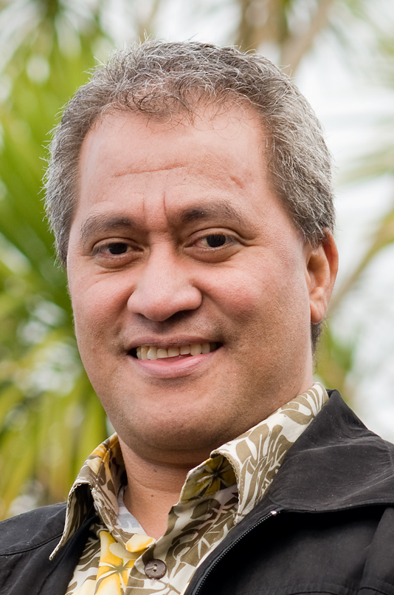
COMP102
Monday - 11/12/17 (Week 14)
Dr. Kerese Manueli
Victoria University of Wellington
New Zealand

Slide 2
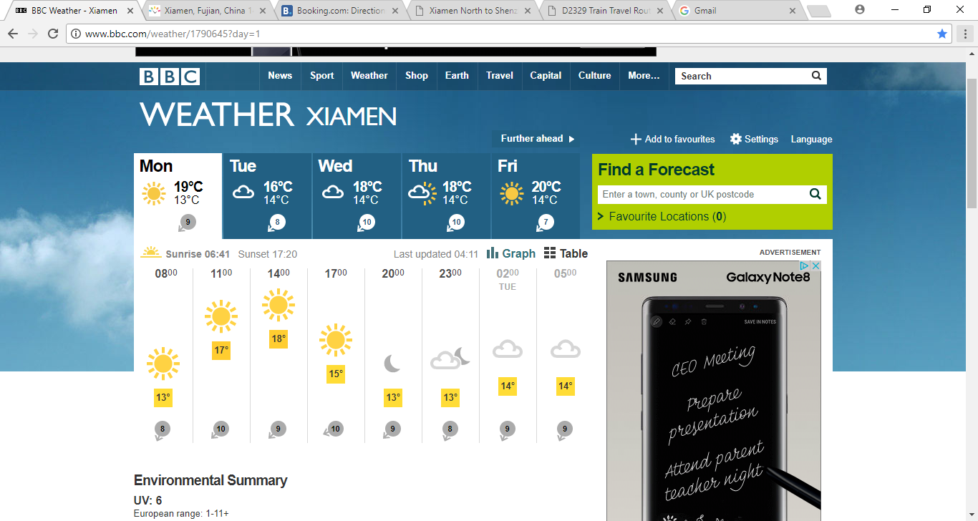

Slide 3
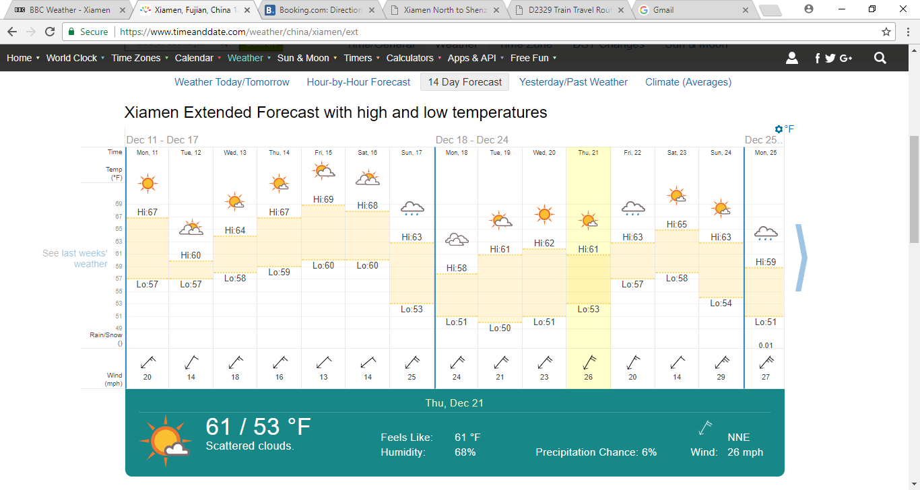

Slide 4
XMUT - COMP102
Menu {Lecture Duration: 8:20-9:05am - 45 mins}
Test 2 (10 mins)
Duration = 90 minutes
Thursday 21 December 2017 @6:30pm
https://ecs.victoria.ac.nz/Main/ExamArchiveCOMP102
Monday class to be held @5:10pm (1 hr)
Event driven inputs (35 mins)

Slide 5
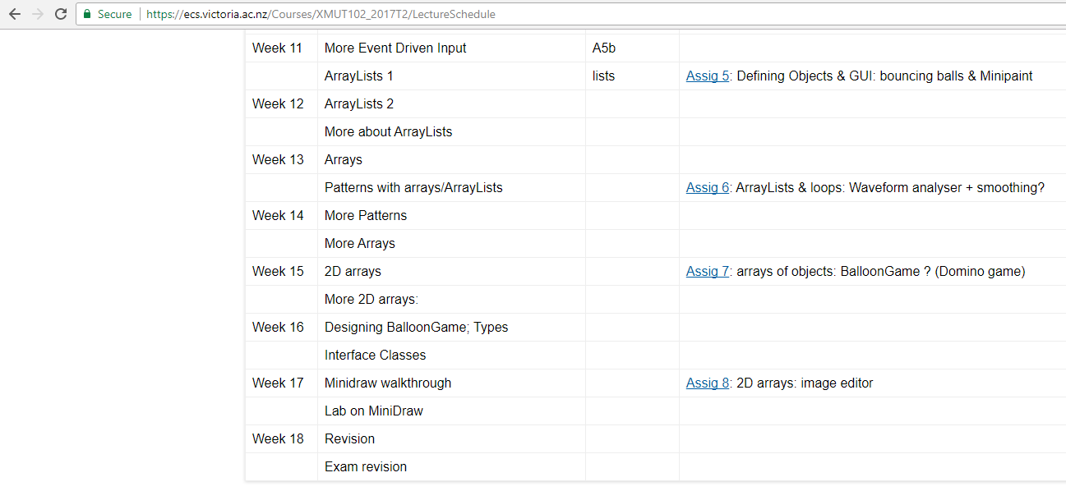

Week 13
Mon 04/12/17
Week 14
Mon 11/12/17
Week 15
Mon 18/12/17

Slide 6
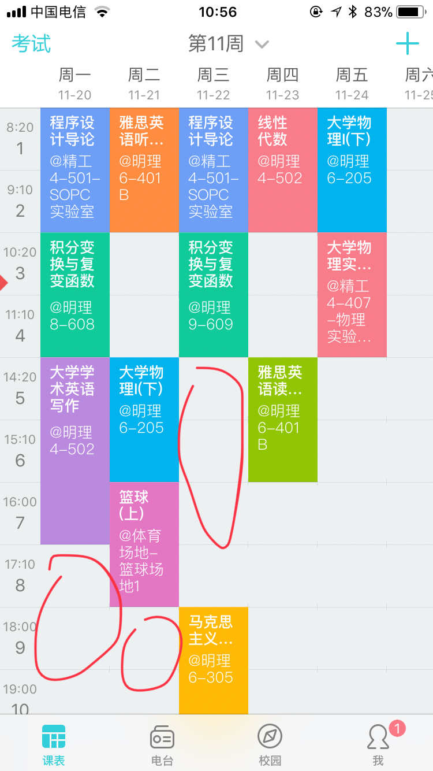
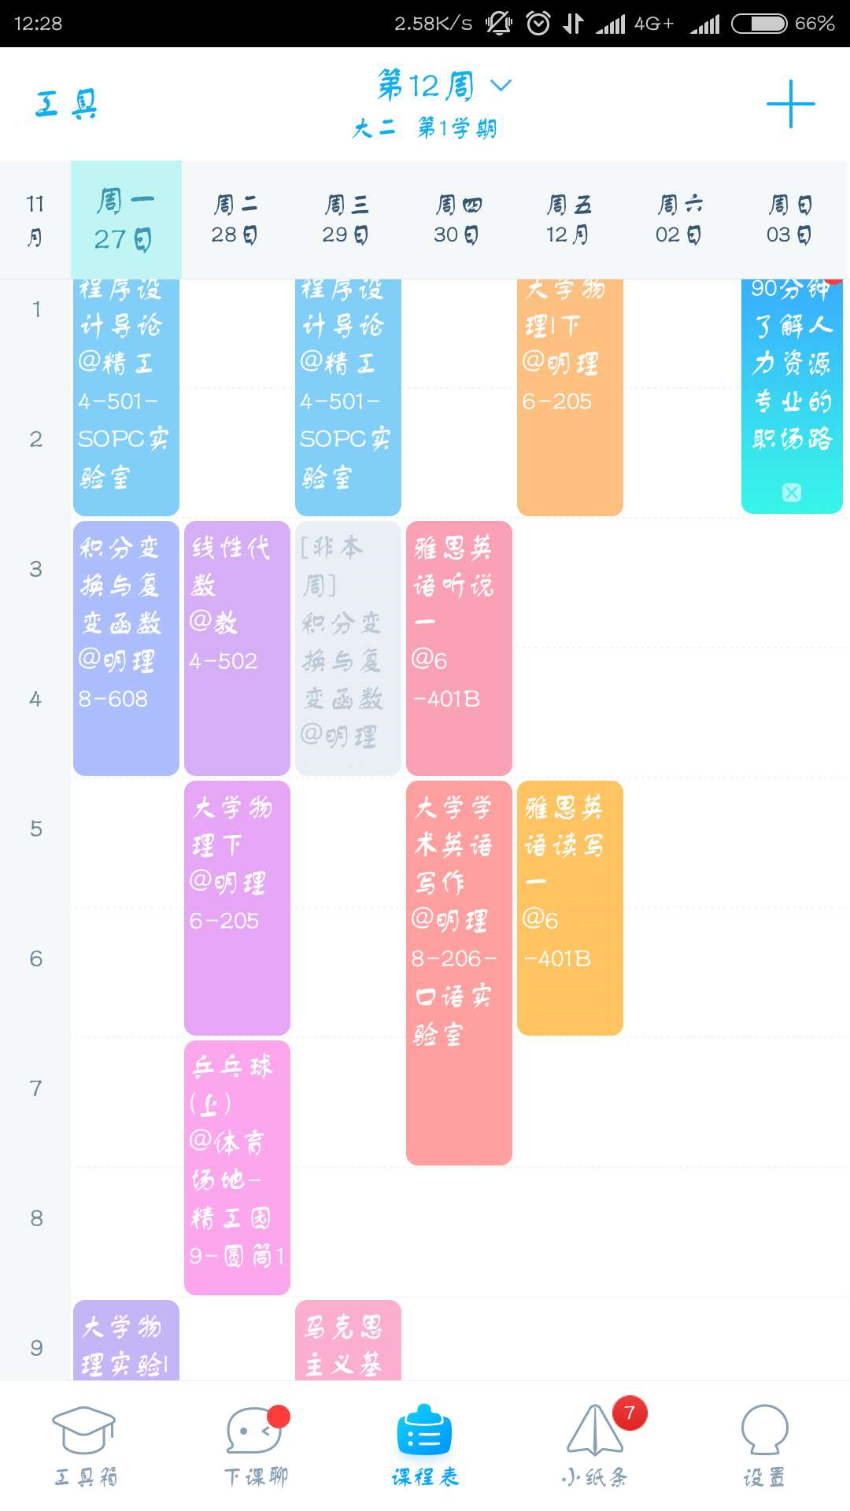
Class 1
Timetable
Class 2
Timetable
Caesar’s
Team
Duncan’s
Team
Maths
Maths
COMP102
Extra
Class

Slide 7
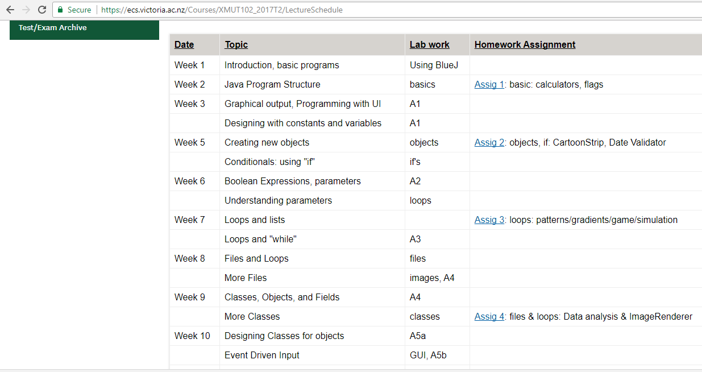

Week 11
Wed 22/11/17
Week 12

